Slide 1


Measuring Components
Part 1
Capacitors
Dr. Norbert Doerry
Dr. John Amy
http://doerry.org/norbert/MarineElectricalPowerSystems/index.htm
© 2025 by Norbert Doerry and John Amy
This work is licensed via: CC BY 4.0 (https://creativecommons.org/)

Slide 2
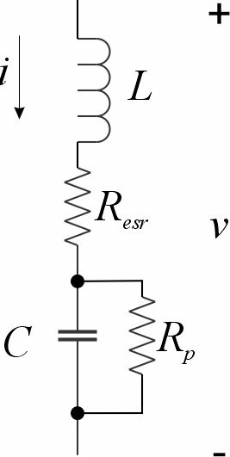
Physical Capacitors
Capacitance (C)
Effective Series Resistance (R_{esr})
Leakage Resistance (R_{p})
Inductance (L)

Slide 3
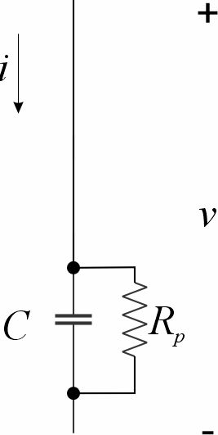
Leakage Resistance
Apply DC voltage through a current limiting resistor.
  Allow for system to reach equilibrium
Measure DC voltage across capacitor and DC current through capacitor
The Leakage Resistance is the ratio of the voltage to the current.
  Assumes the Leakage Resistance is much greater than the Equivalent Series Resistance

Slide 4
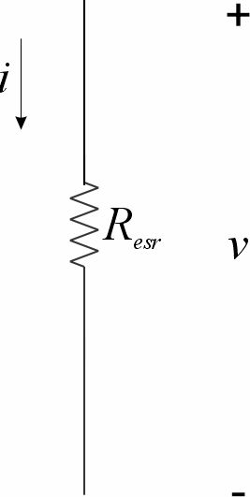
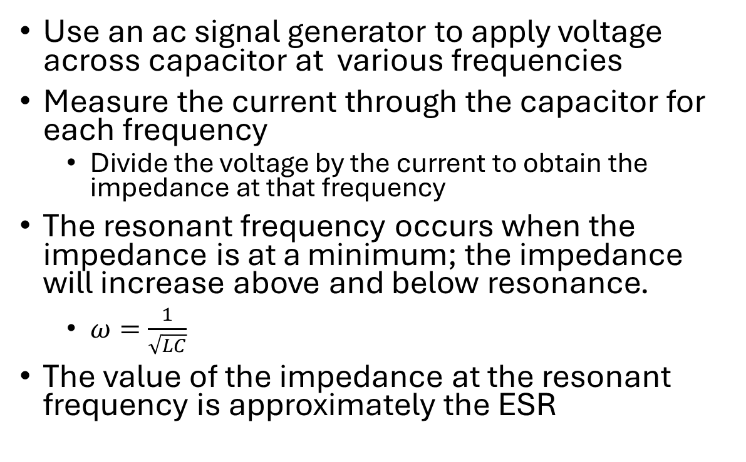
Effective Series Resistance
Use an ac signal generator to apply voltage across capacitor at various frequencies
Measure the current through the capacitor for each frequency
  Divide the voltage by the current to obtain the impedance at that frequency
The resonant frequency occurs when the impedance is at a minimum; the impedance will increase above and below resonance.
  $ω=\frac{1}{\sqrt{LC}}$
The value of the impedance at the resonant frequency is approximately the ESR

Slide 5
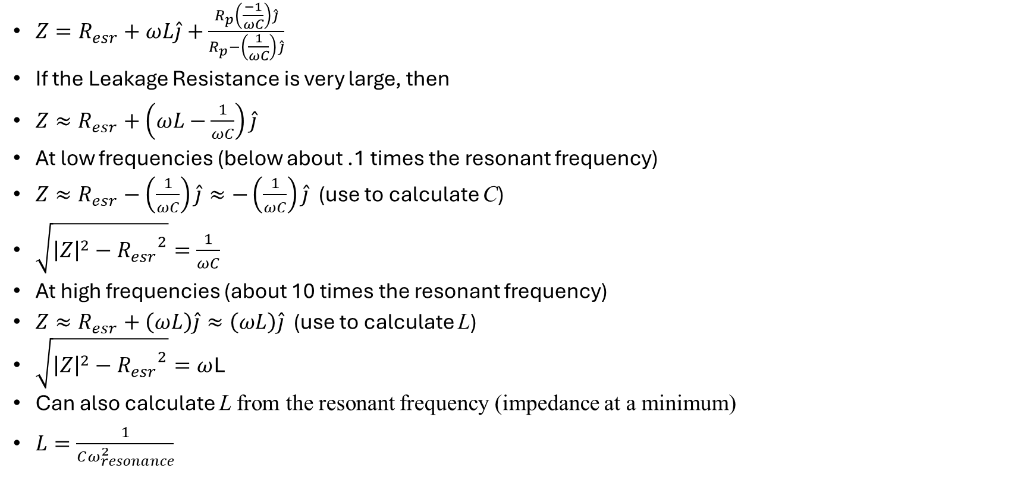
Approach to parameter measurements
$Z=R_{esr}+ωL\hat{j}+\frac{R_{p}\left(\frac{−1}{ωC}\right)\hat{j}}{R_{p}−\left(\frac{1}{ωC}\right)\hat{j}}$
If the Leakage Resistance is very large, then
$Z≈R_{esr}+\left(ωL−\frac{1}{ωC}\right)\hat{j}$
At low frequencies (below about .1 times the resonant frequency)
$Z≈R_{esr}−\left(\frac{1}{ωC}\right)\hat{j}≈−\left(\frac{1}{ωC}\right)\hat{j}$ (use to calculate C)
$\sqrt{{\left|Z\right|}^{2}−{R_{esr}}^{2}}=\frac{1}{ωC}$
At high frequencies (about 10 times the resonant frequency)
$Z≈R_{esr}+\left(ωL\right)\hat{j}≈\left(ωL\right)\hat{j}$ (use to calculate L)
$\sqrt{{\left|Z\right|}^{2}−{R_{esr}}^{2}}=ω$L
Can also calculate L from the resonant frequency (impedance at a minimum)
$L=\frac{1}{Cω_{resonance}^{2}}$

Slide 6
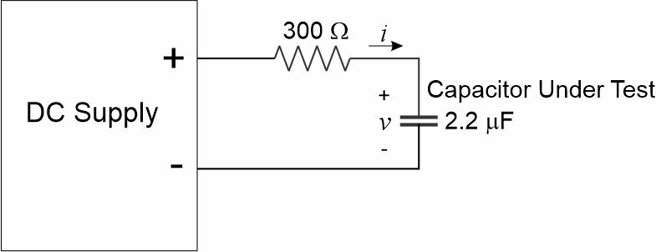

Leakage Resistance Measurement
$$\frac{100 V}{9.5 mA}=11.1kΩ$$

Slide 7
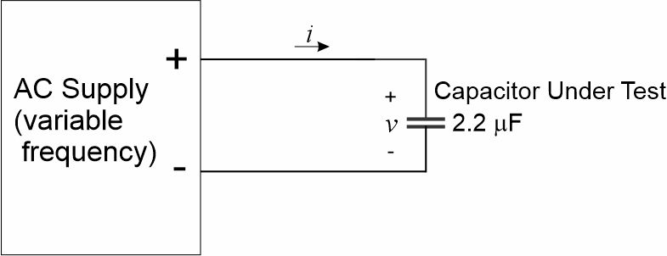
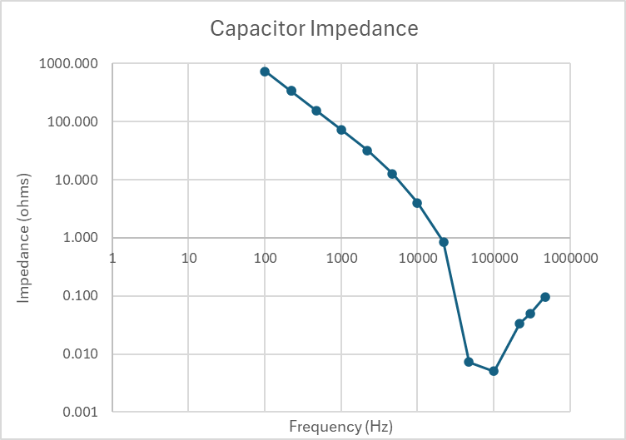
Measurements

Slide 8
Direct Capacitance Measurement

Slide 9
Wrap up

